Slide 1
Five Recommendations for Software Evolvability
Journal of Software: Evolution and Process 30.9 (2018): e1949.
Václav Rajlich
Professor Emeritus
Wayne State University
Department of Computer Science
rajlich@wayne.edu

Slide 2
Evolvability
Successful software requires repeated improvements, i.e. evolution
Evolutionary development processes produce overwhelming majority of software
  Iterative, agile, directed, solo, exploratory, safeguarded, open source, inner source, . . .
Evolvability is a quality that makes evolution possible

Slide 3
Evolvability vs. Maintainability
Evolvability and maintainability are often conflated ISO-IEC 25010.2011 [4]
  Maintenance = preserving status quo
  Evolution = improvements
    Evolution is more demanding than maintenance Sneed, Harry M. "A cost model for software maintenance & evolution." ICSM 2004

Slide 4
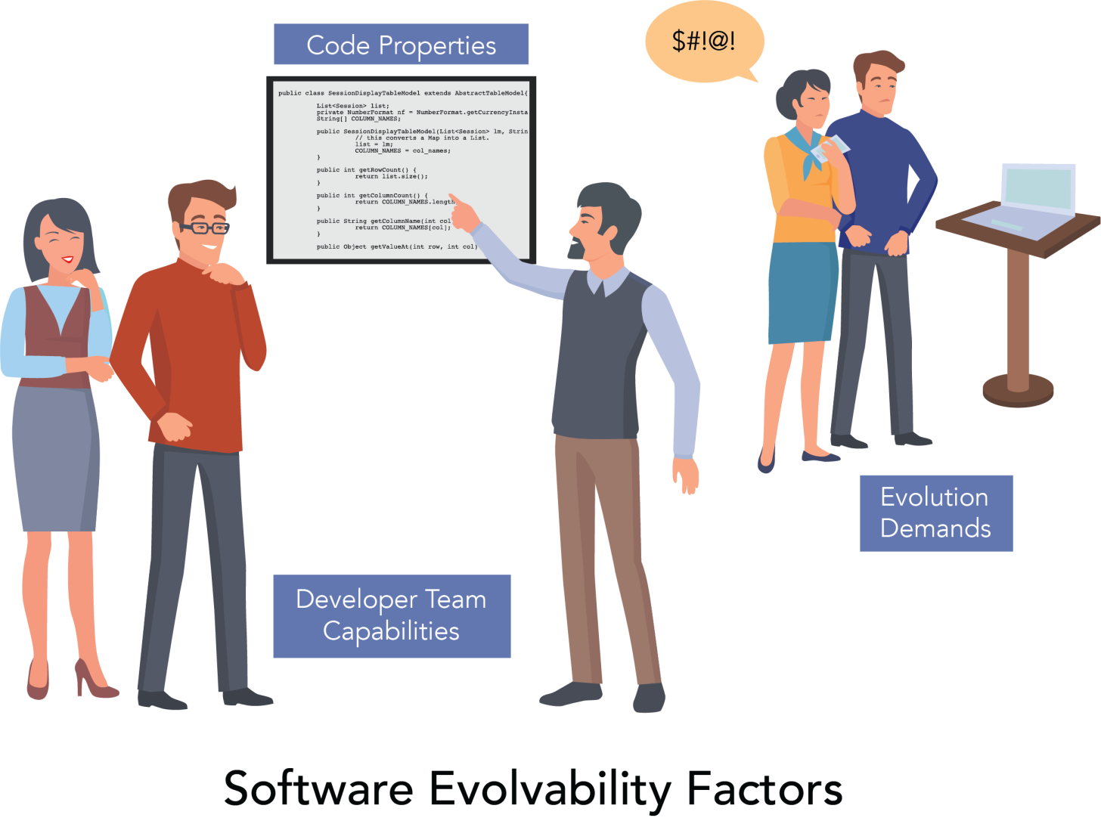
Three Factors of Evolvability

Slide 5
Current situation
Code properties are the current focus
  Numerous recommendations
  Steve McConnell, Code Complete, Robert C. Martin, Clean Code [5]
Need to take into account all three factors
    Software giants have unique developer teams and evolution demands
    Their experience may not fully apply to others
Five specific recommendations presented in this talk

Slide 6
1. Evolution Demands
Evolution demands often surprise developers
Anticipation of the future evolution is always risky
  Wrong decision can backfire
Parnas - always anticipate
Agile - never anticipate
  Searching for a sweet spot

Slide 7
Evolving vs. stabilized part
Software can be divided into two parts:
Evolving part undergoes evolutionary modifications
Stabilized part is not modified
  Stabilized part does not need the expensive evolvable code
  Setting aside stabilized part is an anticipation of future change requests
  Agile assumes all code is evolvable

Slide 8
Recommendation 1
The whole team or the managers should explicitly approve all anticipations
  Not individual developer
  The approval should be an explicit part of the development process
Division of software into evolvable and stabilized part is one such anticipation

Slide 9
2. Analyzable Segments
Analyzability is a part of evolvability [3,4]
Determination of a unit responsibility
  Frequent evolution question
    “What does this unit do?”
    Comprehension, unit testing
Unit delegates part of its responsibility to suppliers
  class Item has supplier class Price

Slide 10
Segment definition
Unit A is dependent on B, denoted <A,B>
  B is a supplier of A
A dependency graph D is a directed graph
  nodes are units of the program
  edges are dependencies
Supplier segment of unit X
  seg(X) = {A | A = X or there is a dependency <Y, A> ∈ D such that Y ∈ seg(X)}
  Supplier segment implements responsibility

Slide 11
Dangerous software constructs
They make static analysis of dependencies (and segments) difficult In defense of soundiness: a manifesto [31]
  Pointer arithmetic in C++
  Reflection in Java
  Dangerous software constructs proliferate in new languages

Slide 12
Recommendation 2
Evolvable code must be analyzable
  No dangerous constructs in evolvable code
Project team selects a normative tool T
  Supplier segments in evolvable code identified by T
  must have recall 100% (safety)
  good precision (80%?)
  the analysis must be fast
    (no longer than 30 sec?)

Slide 13
3. Defined Processes Of Software Change
Undefined processes differ from developer to developer and from task to task
  Do not offer predictable productivity and quality
Adoption of defined processes has led to improvements in software productivity and quality [22]
A defined process of software change can lead to similar results

Slide 14
Phased Model of
Software Change (PMSC)
For changes that localize, i.e.
  Most perfective changes
  Many corrective changes
  Many adaptive changes
  V. Rajlich, Software Engineering: The Current Practice
Initiation
Concept Location
Impact Analysis
V
E
R
I
F
I
C
A
T
I
O
N
Prefactoring
Actualization
Postfactoring
Conclusion

Slide 15
Other less explored processes
Changes that start with a symptom
  Require diagnostic phase [21,28]
  Many corrective changes are in this category
Massive changes [29]
  Adaptive changes
  A fundamental assumption of software must be changed
  Bad news for the project

Slide 16
Recommendation 3
  Continue research of the processes of software change
  Use defined processes in the projects

Slide 17
4. Significant Concepts
The code is an implementation of a collection of concepts
Concept location indicates which of these concepts need to be modified
  Significant concepts (of the change) [23]

Slide 18
Encapsulation
Evolution is facilitated if each significant concept is encapsulated in a specific code unit
  The unit contains complete implementation of the concept
  Makes the significant concepts easier to find, comprehend, and modify

Slide 19
Delocalized concepts
A concept spans several units
Hidden concept is an extreme case of concept delocalization
Concepts is not encapsulated as a type, but its representation is being used by the clients
    Kilograms that are represented by plain floating point numbers
    Synonyms hidden dependencies [33], cross-cutting concerns [34]

Slide 20
Problem with hidden concepts
Hidden concepts can become significant concepts of a change
  Change request demands to change kilograms to pounds
The code modification must be made consistently in all places where the hidden type is used
  Can lead to massive changes

Slide 21
Processes as significant concepts
Strict Object Oriented programming localizes only types (as classes)
Imperative programming localizes processes as functions
Sometimes we need both

Slide 22
Example: Student registration
In strict OO, the “student registration” is divided into small pieces that belong to classes Student, Transcript, Course, …
All these pieces have to be located before a modification of the registration process
  Strict OO implementation is unfriendly towards changes in registration process
There should be a functions that encapsulates entire process [35, 36]

Slide 23
Recommendation 4
Be judicious which concepts you encapsulate
If a concept is likely to change in the future, encapsulate it!
  Do not use hidden concepts implementation if that concept is likely to change in the future
  Encapsulate functions rather than types when dealing with changing processes, no matter what textbooks say

Slide 24
5. Moderate Use of Wrapping
The original purpose of software design patterns is reusability [37]
Reusability patterns may hinder evolution and hence they may be evolvability antipatterns [38]
Nowhere is this difference clearer than with adapter pattern, aka wrapper [37].

Slide 25
Wrapper
Client expects different contract than what the supplier offers
Instead of changing the code of either supplier or client, wrapper is an extra unit placed between the supplier and client
It translates the supplier responsibility in such a way that the client expectation is satisfied

Slide 26
Pros/Cons of wrapper
Wrapper provides a fast correction of the mismatch between two units
  Compared to PMSC, effort saving can be substantial
Wrappers delocalize concepts because parts of the impacted concepts are now in the supplier and parts are in the wrapper
  Accumulation of wrappers can destroy evolvability

Slide 27
Recommendation 5
Use wrapping in evolvable code sparingly
Make use of wrapping a team/management decision

Slide 28

  Fault line of software development
Initial development
  Fast
Evolution
  Evolvability = Quality
  Demand better languages and tools
Five recommendations in this paper
  More should be investigated

