Slide 1

Chapter 2
www.tanbooks.com

Slide 2
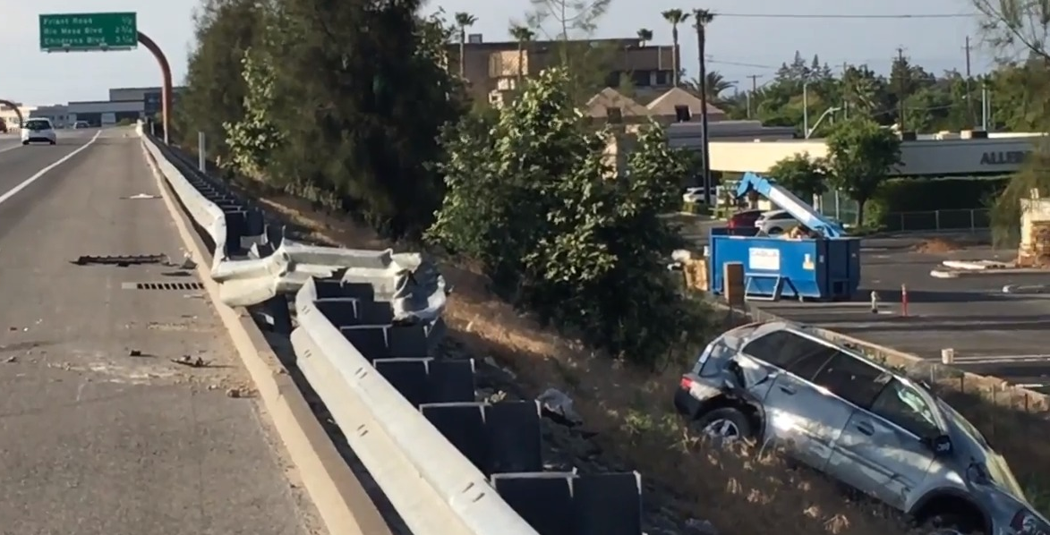
P1 Prohibited Acts
Not everything we can do we should do

Slide 3
Prohibitions
Conceptually very simple: Do not …
Small children can understand and learn them
New Testament prohibitions are few and brief
  They are applied broadly
  Comparable to dangerous precipice
Adherence allows us to search for Kingdom of God

Slide 4
You Shall Not Kill
Foundation of civilized life
Jesus expands this commandment
  Prohibits any injury to any human being
  A bodily injury or a psychological one
"You have heard that it was said to the men of old, 'You shall not kill; and whoever kills shall be liable to judgment. But I say to you that every one who is angry with his brother shall be liable to judgment; whoever insults his brother shall be liable to the council, and whoever says, 'You fool!' shall be liable to the hell of fire.” (Mt 5:21-22)

Slide 5
You Shall Not Commit Adultery
Jesus prohibits any sexual acts except those between a husband and wife within a lifelong marriage that are open to life
Why are New Testament teachings on sexuality so strict?
  Sexuality is closely tied to human life
  New life deserves protection from the very beginning and that can be guaranteed only if the life begins in orderly circumstances

Slide 6
Difficult battle
Sexual drive is indeed one of the most powerful natural human instincts
  Battle starts during one’s teenage years and continues throughout one’s whole adult life
If unchecked, sexual drive can turn our earthly life into a wreck and block us from reaching the Kingdom of God
“You are not your own; you were bought with a price. So glorify God in your body.” (1 Cor 6:19-20)

Slide 7
You Shall Not Steal
This prohibition requires respect for the property of others.
Societies that do not or cannot protect property experience chaos and poverty.
St. Paul implores thieves to change their ways (Eph 4:28).

Slide 8
You Shall Not Bear False Witness
Jesus applies a broad interpretation of this commandment and disallows all lying
  Any intentionally misleading statement
Lying can be addictive because it offers an easy escape out of unpleasant situations
Telling truth has to be constantly practiced, even in small things
Big goals cannot be reached without truth

Slide 9
How truth can be twisted
False witness
Perjury
Euphemism
Spin
Disinformation
Noble lie
White lie
Glamorous lie

Slide 10
How truth can be twisted (2)
Calumny
Coercive lie
Bullying lie
Beyond the pale
Pathological liar
Denial
Sucker (dupe)

Slide 11
Sin
Mortal sin is the conscious and voluntary transgression in grave matter
  It totally sabotages the goals of reaching the Kingdom of God
  The New Testament counsels avoiding them under any circumstances and at any personal cost
  “He who commits sin is of the devil; for the devil has sinned from the beginning…” (1 Jn 3:8)
  More on that when we talk about God’s grace – P4

Slide 12
Venial sin
Analogy of the Hannah’s road trip to Chicago
  Minor traffic violations
  Slightly exceeding the speed limit
  Increased risk of an accident and may result in a traffic ticket
  Still allow her to continue driving to Chicago.

Slide 13
Battle of heart
Our thoughts, dreams, fantasies, plans, and attitudes, sooner or later result in outward deeds
“For from within, out of the heart of man, come evil thoughts, fornication, theft, murder, adultery, coveting, wickedness, deceit, licentiousness, envy, slander, pride, foolishness. All these evil things come from within, and they defile a man” (Mk 7: 21-23)

Slide 14
Battle of heart (2)
Lifelong battle that is never fully won
Pharisees who misunderstood this connection and concentrated only on visible acts
Jesus likened them to "whited sepulchers... full of all filthiness" (Mt 23:27).

Slide 15
Legalism
Ethical systems where prohibitions are the only ethical principle
Prohibitions are complemented by legal duties which compel certain actions
  Prohibitions against inaction in certain situations

Slide 16
Problems of legalism
Attempt to define precise boundaries between prohibited and permitted
Fallacy that considers everything that is legal to be also moral
It is possible to wrong someone by perfectly legal means.

Slide 17
Loopholes
How far can I go without violating the prohibition?
Legalists try to close these loopholes through various contingencies and stipulations
This leads to an explosion in the number and complexity of laws

Slide 18
Pharisees
The Pharisees tried to construct the entire ethical system as a system of prohibitions
  Ended up with a hugely complex system
  Some of their prohibitions lacked common sense
Jesus counsels
  Strict observance of some laws (Mt 5:21-22)
  Loose approach to other laws - Sabbath (Lk 6:6-11)
  This paradox is explained by different reasoning in different pillars

Slide 19
Questions
1. List contemporary offenses against the prohibition “You shall not kill” that society tolerates.
2. How is the commandment “You shall not commit adultery” applied in the New Testament?
3. What is wrong with white lies? Noble lies?
4. Is the observance of prohibitions sufficient to reach the Kingdom of God?

